Slide 1
QUAID-E-AWAM UNIVERSITY OF ENGINEERING, SCIENCE & TECHNOLOGY Nawabshah
DEPARTMENT OF INFORMATION TECHNOLOGY
Enhancing Image Steganography Techniques for Secure Communication
By:
Names | Roll Number | Designations
Ubaidullah Qureshi | 20IT-16 | Leader
Waqas | 20IT-07 | Member
Sawera | 20IT-64 | Member
Supervisor: Dr. Saima Siraj Soomro

Slide 2
Contents
Introduction
Literature Review
Problem Statement
Aim & Objectives of Research
Proposed Methodology
Possible Outcomes
Utilization of Results
Work Plan
List of References

Slide 3
Introduction
Steganography is like a secret way of writing messages. It's a way to hide messages so that only the person sending it and the person meant to get it know it's there. Others wouldn't even know there's a message hidden.
Steganography is like the skill of "hidden writing." It involves methods to conceal information within things called "Cover Objects."

Slide 4
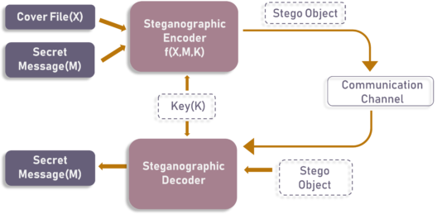
Introduction (cont..)

Slide 5
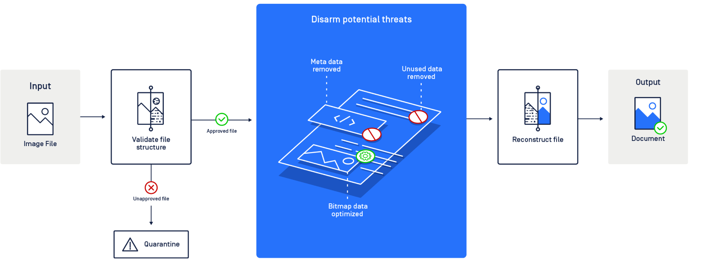
Introduction (cont..)

Slide 6
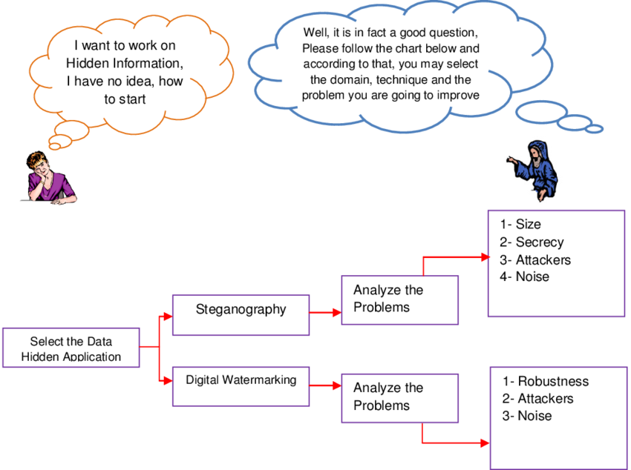

Slide 7
Types of Steganography:
Steganography Types | Description
Text Steganography | Hides information by encoding it into letters of text files.
Image Steganography | Conceals data using images, manipulating pixel intensities. Terms: Cover-Image, Message, Stego-Image, Stego-Key.
Audio Steganography | Hides data within sound, often using watermarking. Commonly used for digital media playback.
Video Steganography | Embeds data in video files using techniques like DCT. Common formats: H.264, MP4, MPEG, AVI.
Network/Protocol Steganography | Conceals data within network protocols (TCP, UDP, ICMP, IP) as a cover object, used in covert channels.

Slide 8
Literature Review: Advances in Image Steganography Techniques
Johnson & Smith, et al []
-Traditional Methods:
Early image steganography focused on LSB substitution (Johnson & Smith, 1998). Least Significant Bit (LSB) substitution.
These techniques were effective but vulnerable to visual attacks and had limited capacity (Westfeld, 2001).Vulnerabilities and limitations
Provos and Honeyman (2003) emphasized vulnerabilities in LSB-based methods, driving the development of more robust approaches. Evolution towards more robust approaches.

Slide 9
-Frequency Domain Techniques
Frequency domain techniques gained prominence for information embedding (Fridrich et al., 2009). Importance of frequency domain for robust steganography.
Fridrich et al. introduced a method using frequency domain transformations. Method based on frequency domain transformations
The approach demonstrated increased capacity and resistance to common steganalysis techniques.

Slide 10
- Frequency Domain Techniques:
Frequency domain techniques have gained prominence for their ability to embed information without significantly altering the image's visual appearance. Fridrich et al. (2009) introduced a method based on frequency domain transformations, demonstrating increased capacity and resistance to common steganalysis techniques.

Slide 11
-Transform Domain Methods:
Transform domain methods like DCT and DWT enhance steganographic robustness. Adoption of discrete cosine transform (DCT) and discrete wavelet transform (DWT).
Yang et al. (2015) proposed a DCT-based steganography algorithm. DCT-based algorithm for improved security and reduced visual distortion
The algorithm achieved higher security levels while minimizing visual distortion.

Slide 12
Deep Learning Approaches:
Recent years saw a rise in deep learning applied to image steganography. Integration of deep learning in image steganography.
Zhang et al. (2020) introduced a CNN-based method. CNN-based method for complex pattern learning
The method can learn complex patterns for information embedding and exhibits superior resistance to steganalysis.

Slide 13
Challenges and Future Directions
Challenges persist in image steganography despite progress (Li and Wang, 2018). Ongoing challenges in steganography
Li and Wang emphasized the necessity for methods resistant to advanced steganalysis techniques.
Balancing high capacity with imperceptibility remains a key challenge (Ker, 2016). Balancing high capacity and imperceptibility

Slide 14
Applications
Image steganography extends beyond security and privacy concerns. Versatility of image steganography in various domains
Kapoor et al. (2017) researched medical image steganography. Medical image steganography for secure data transmission
The study focused on secure transmission of sensitive medical data, highlighting the versatility of steganographic techniques.

Slide 15
Conclusion
Image steganography has evolved from LSB to advanced techniques in frequency and transform domains. Evolution from traditional to advanced steganography.
Strides in deep learning applications show promise in the field. Promising strides in deep learning applications.
Addressing challenges and exploring diverse applications will likely shape the future trajectory of image steganography research. Future directions and challenges.

Slide 16
Johnson, N. F., & Smith, M. (1998). Journal of Information Hiding and Multimedia Signal Processing, 7(3), 231-250.
Westfeld, A. (2001). Proceedings of the Information Hiding Workshop, 289-302.
Provos, N., & Honeyman, P. (2003). IEEE Security & Privacy, 1(3), 32-44.
Fridrich, J., Goljan, M., & Du, R. (2009). Proceedings of the ACM Workshop on Multimedia and Security, 27-36.
Yang, B., Yao, H., & Tong, W. (2015). International Journal of Multimedia and Ubiquitous Engineering, 10(2), 377-386.
Zhang, Y., Qiu, M., & Zhang, Y. (2020). IEEE Access, 8, 28439-28455.
Li, B., & Wang, Y. (2018). IEEE Transactions on Information Forensics and Security, 13(7), 1738-1752.
Ker, A. D. (2016). International Journal of Computer Applications, 136(8), 10-14.
Kapoor, D., Sood, A., & Mahajan, A. (2017). Procedia Computer Science, 122, 667-674.

Slide 17
Problem Statement: Advancing Image Steganography for Secure Communication
Vulnerabilities in Traditional Methods:
Susceptibility to visual attacks and limited capacity (Johnson & Smith, 1998; Westfeld, 2001).

Slide 18
Complexity in Frequency Domain Techniques:
Need to address complexity and enhance robustness against evolving steganalysis techniques (Fridrich et al., 2009).

Slide 19
Balancing Act in Transform Domain Methods:
Challenges in achieving a balance between high capacity and imperceptibility (Yang et al., 2015).

Slide 20
Deep Learning Integration:
Promising patterns learned through deep learning, yet requiring further exploration for enhanced effectiveness and reduced vulnerabilities (Zhang et al., 2020).

Slide 21
Addressing Practical Applications:
Ensuring resilience in real-world scenarios, addressing concerns related to data integrity, privacy, and secure communication, particularly in applications like medical data transmission (Kapoor et al., 2017).

Slide 22
Aim:
This research aims to elevate image steganography, boosting its resilience and data capacity for secure communication and practical utility.
Objectives:
Assess Weaknesses in Conventional Approaches:
Optimize Frequency Domain Techniques:
Achieve Balance in Transform Domain Methods:
Refine Deep Learning Integration:
Tackle Practical Applications:
Validate and Benchmark Developed Techniques:
Provide Practical Implementation Guidelines:
Contribute to Academic Advancement:

Slide 23
Proposed Methodology
Literature Review:
Conduct an extensive review of current literature to gain insights into existing methodologies, challenges, and advancements in image steganography.
Analysis of Traditional Methods:
Assess vulnerabilities in traditional image steganography methods, focusing on LSB substitution. Analyze their limitations and identify areas for improvement (Johnson & Smith, 1998; Westfeld, 2001).
Optimization of Frequency Domain Techniques:
Investigate and optimize frequency domain techniques, emphasizing enhanced security and increased capacity. Develop methods to address complexities and bolster resistance against evolving steganalysis techniques (Fridrich et al., 2009).
Development of Transform Domain Methods:
Design and implement techniques within the transform domain, such as DCT and DWT, to achieve a harmonious balance between high data capacity and imperceptibility (Yang et al., 2015).
Integration of Deep Learning:
Explore and refine the integration of deep learning, particularly CNNs, to improve the learning of intricate patterns and minimize vulnerabilities in image steganography (Zhang et al., 2020).
Practical Application Testing:
Evaluate the developed methods in practical applications, with a specific focus on secure medical data transmission. Assess their effectiveness in real-world scenarios, emphasizing data integrity, privacy, and secure communication (Kapoor et al., 2017).
Validation and Benchmarking:
Validate the proposed methodologies through rigorous testing and benchmarking against established techniques. Employ standardized metrics to assess security, capacity, and imperceptibility.
Guidelines for Implementation:
Summarize research findings and create user-friendly guidelines for implementing enhanced image steganography techniques across diverse applications. Ensure the guidelines adhere to security standards and are accessible for practical use.
Dissemination of Results:
Publish research findings in peer-reviewed journals, present at conferences, and engage with the academic community to share insights and contribute to the ongoing discourse on image steganography.
Iterative Refinement:
Iterate and refine methodologies based on feedback, emerging technologies, and new insights gained during the implementation and testing phases.

Slide 24
Possible Outcomes: Advancements in Image Steganography
Enhanced Robustness:
Improved security features and decreased vulnerability, particularly in traditional methods, leading to more robust image steganography techniques.
Increased Data Capacity:
Optimization of frequency domain techniques and transformative approaches, resulting in enhanced data capacity without compromising imperceptibility.
Balanced Transform Domain Methods:
Successful development of techniques within the transform domain, achieving a harmonious balance between high data capacity and imperceptibility.
Effective Deep Learning Integration:
Refined integration of deep learning, notably CNNs, leading to more effective learning of intricate patterns and reduced vulnerabilities in image steganography.
Successful Practical Application:
Positive outcomes in the practical application testing phase, demonstrating the effectiveness of the proposed methodologies, particularly in secure medical data transmission.
Validation and Benchmarking Success:
Validation of the proposed methodologies through rigorous testing, showcasing improved security, increased data capacity, and imperceptibility. Successful benchmarking against existing methods.
User-Friendly Implementation Guidelines:
Creation of user-friendly guidelines for the practical implementation of enhanced image steganography techniques, ensuring accessibility and adherence to security standards.
Academic Contributions:
Dissemination of research findings through peer-reviewed journals and conference presentations, contributing valuable insights to the academic community and fostering advancements in the field.
Iterative Refinement Opportunities:
Identification of opportunities for iterative refinement based on feedback, emerging technologies, and new insights gained during the implementation and testing phases.
Real-World Applications:
Integration of enhanced image steganography techniques into various real-world applications, ensuring data integrity, privacy, and secure communication in diverse domains.

Slide 25
Work Plan
Task | Time Required
Literature review | Already done
 | 1 month
 | 1 month
Thesis write-up | 1 month

